Slide 1






Romantic Poetry
Identifying Tone in John Keats’ “Ode to a Nightingale”
Presented by: Lauren Cottle

Slide 2

Overview
  Background Info
  Tone definition
  The poem
  Activity

Slide 3
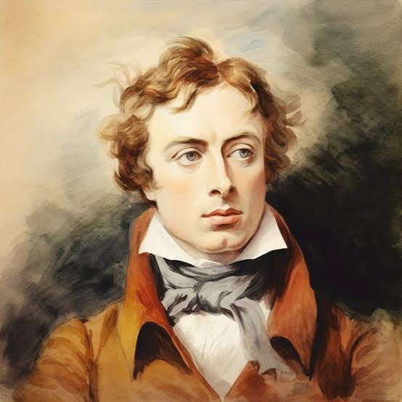



Background information
John Keats
(1795 - 1821)
Keats was the Model of the “Romantic” poet: tragically young, intensely introspective, brooding on love and death, writing alone to the song of the nightingale
What is Romantic poetry?
Literary movement in Europe between 1800-1850 that focuses on the poet’s inner world and perception of the natural world.

Slide 4





Understanding Tone
Compare
Definition
Literature
What a great idea!!
The tone is the attitude that your friend is taking to the proposal. This is signaled by the words and the emojis.
The attitude of a character or speaker towards a given subject.
What a great idea!! 🙄
What a great idea!! 👿

Slide 5



Understanding Tone
How do we identify tone?
  Diction: word choice
The Poem
  How does the speaker see the nightingale?
  How does this relate to how the speaker views themself?

Slide 6
Ode to a Nightingale
My heart aches, and a drowsy numbness pains
My sense, as though of hemlock I had drunk,
Or emptied some dull opiate to the drains
One minute past, and Lethe-wards had sunk:
'Tis not through envy of thy happy lot,
But being too happy in thine happiness,—
That thou, light-winged Dryad of the trees
In some melodious plot
Of beechen green, and shadows numberless,
Singest of summer in full-throated ease.

Slide 7
Ode to a Nightingale
My heart aches, and a drowsy numbness pains
My sense, as though of hemlock I had drunk,
Or emptied some dull opiate to the drains
One minute past, and Lethe-wards had sunk:
'Tis not through envy of thy happy lot,
But being too happy in thine happiness,—
That thou, light-winged Dryad of the trees
In some melodious plot
Of beechen green, and shadows numberless,
Singest of summer in full-throated ease.

Slide 8






Activity time
Read the next stanza of “Ode to a Nightingale”
Highlight key words or phrases that have an emotional charge.
Using your understanding of tone, write 2-3 sentences on how the speaker feels about the subject (the nightingale).
We will discuss together as a class.

