Slide 1





Verizon Business Group Slack Escalations
November 2023
Verizon confidential and proprietary. Unauthorized disclosure, reproduction or other use prohibited.

Slide 2



Intro / Statement
95%
95% of ALL VBG Escalation Submissions contain inaccurate and/or missing vital information. With changing to the new slack workflow model we will be able eliminate missing information and provide a better user experience.
Verizon confidential and proprietary. Unauthorized disclosure, reproduction or other use prohibited.
2

Slide 3
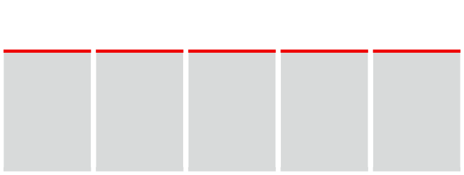
NEW Slack VBG Escalations Process
The new Slack VBG Escalations Process will make escalations more eﬃcient, cost reductive, and easier for both Verizon Wireless and Verizon Connect employees.
One Stop Shop
Response Time
More Support
Correct info
Familiar Format
•
Currently reps must fill out two lengthy forms.
The new process
reduces it to one
condensed form.
•
Current response time for escalations is 17 days.
The new process
with less steps will
reduce this
response time.
•
The new form will allow more people to work on escalations.
This will create
more eﬃciency
and a better
workflow.
•
The Slack escalations form will allow the escalations team to respond to reps in real time, reducing steps in process.
•Slack is a familiar
format for reps, which will reduce confusion and encourage good behavior in filling out the form with the relevant info.
•
•
•
Verizon confidential and proprietary. Unauthorized disclosure, reproduction or other use prohibited.
3

Slide 4
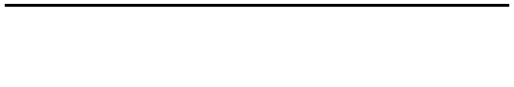
NEW Slack VBG Escalations Process
95% of ALL VBG Escalation Submissions contain inaccurate and/or missing vital information. With changing to the new slack workflow model we will be able eliminate missing information and provide a better user experience.
One Stop Shop
Response Time
More Support
Correct info
Familiar Format
•
Currently reps must fill out a lengthy form.
The new process
reduces it to one 7
question form.
•
Current response time for escalations is 17 days.
The new process
with less steps will
reduce this
response time.
•
The new form will allow more people to work on escalations.
This will create
more eﬃciency
and a better
workflow.
•
The Slack escalations form will allow the escalations team to respond to reps in real time, reducing steps in process.
•Slack is a familiar
format for reps, which will reduce confusion and encourage good behavior in filling out the form with the relevant info.
•
•
•
Verizon confidential and proprietary. Unauthorized disclosure, reproduction or other use prohibited.
4

Slide 5

NEW Escalations Process
The new escalation process will reduce the unnecessary steps, creating a more eﬃcient system.
Step 1
Step 2
Step 3
VBG Rep fills out the Slack form
Escalations team approves or rejects
Escalations team responds to case
11 Steps VS 3 Steps *create this*
•
The Slack form is condensed and easier to fill out.
•
If rejected, the escalations team can respond in Slack to ask for relevant info.
•
Once the escalations team has all relevant information, they can respond to the case.
Verizon confidential and proprietary. Unauthorized disclosure, reproduction or other use prohibited.

Slide 6

Benefits of new Slack VBG Escalations Process
1 2 3
Slack format is familiar to VBG employees, which will encourage correct behavior for reps entering in case number and contact information.
The new process will reduce the number of forms reps need to fill out from 2 to 1, creating a one-stop shop for the escalations process.
Slack VBG Escalations will allow the escalations team to respond quickly to reps, making the process more eﬃcient.
Verizon confidential and proprietary. Unauthorized disclosure, reproduction or other use prohibited.
6

Slide 7
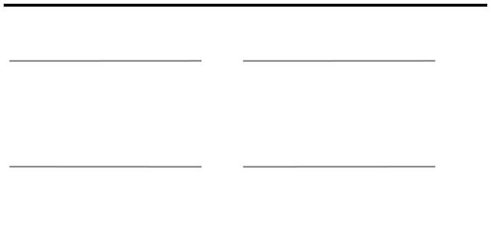
Key problems that the new process will address
Incorrect or missing information
Multiple forms to fill out
The current Google form for escalations has resulted in several VBG Reps failing to include case numbers and/or contact information, which prevents the escalation team from responding to escalations in a timely manner. The new form is condensed and requires the case number to be entered before submitting.
Currently, reps are filling out both a Google form and a Slack form to initiate the escalations process. The new form will be a one stop shop for reps to file an escalations, saving valuable time for both employees and customers.
Response time for escalations
Delayed response from reps
The current response time for escalations is an average of 17 days. With the new process, the information will be consolidated into one form, which will reduce time and make the process more eﬃcient.
Currently, the escalations team reaches out to reps via email for more info. These emails are either ignored or responded to in a delayed manner. The new process has the escalations team responding to reps in real time to ask for information rather than waiting for an email.
Verizon confidential and proprietary. Unauthorized disclosure, reproduction or other use prohibited.
7

Slide 8
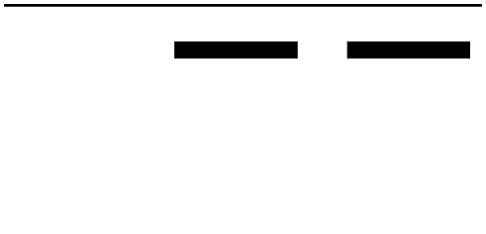

Let’s look at the numbers
Current
New
30%
10%
17
Escalations should be rejected, which will lead
The amount of escalations that are rejected
currently.
to a quicker response from reps to include all
relevant information.
20%
Days is the current average response time for escalations.
45%
Reduction in steps to resolution with current
process.
Estimated reduction in steps to resolution with
new process.
Verizon confidential and proprietary. Unauthorized disclosure, reproduction or other use prohibited.
8

Slide 9
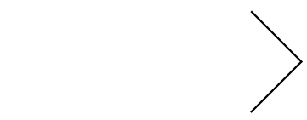

Key results of new Slack VBG Escalations Process
•Only one form for reps to fill out. •Solves problem of missing information. •Empowers escalation team to respond quickly. •Reduces steps for quicker response. •Improves response time for customers. •Multiple people can handle escalations.
Quicker response time for escalations. Improved process saves both time and resources.
The new escalations process improves eﬃciency and reduces the steps to resolution.
Verizon confidential and proprietary. Unauthorized disclosure, reproduction or other use prohibited.
9

Slide 10


Verizon confidential and proprietary. Unauthorized disclosure, reproduction or other use prohibited.

Slide 11

Current escalations process
The current escalations process leads to a delayed response time from the team due to unnecessary steps.
Step 1
Step 2
Step 3
Step 4
Step 5
VBG Rep fills out the Google form.
VBG Rep fills out the Slack form
Escalations team sorts the info from both forms
Potential delayed response from reps.
Response from escalations team
•
The Google form is long and potentially confusing for reps, leading to missing information.
•
Both the Slack form and the Google form goes to the escalations team.
•
The escalations team will reach out to reps if there is information missing.
•
Lack of timely response leads the escalations team to search for the information and adds further delay.
•
Once the escalations team has all relevant information, they can respond to the case.
Verizon confidential and proprietary. Unauthorized disclosure, reproduction or other use prohibited.
11

